Slide 1
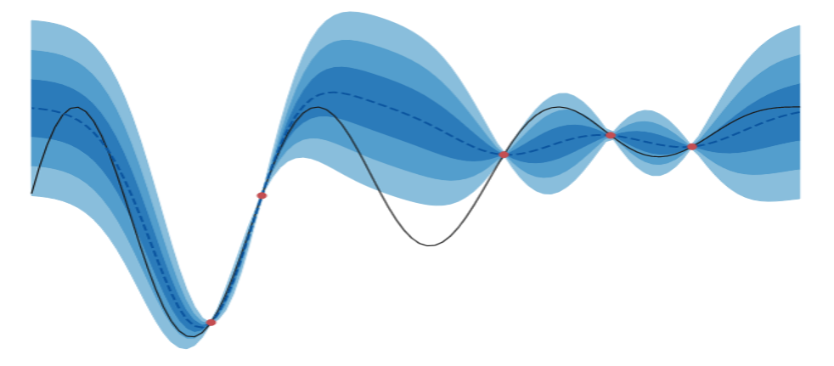
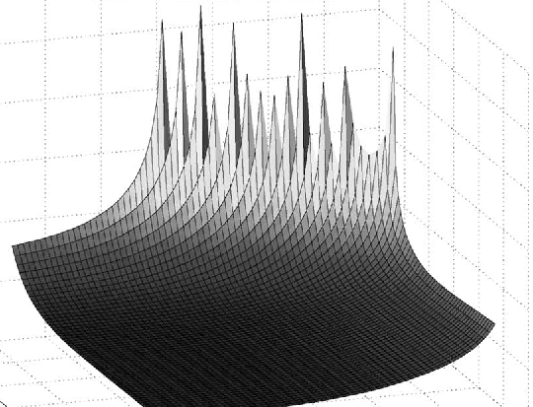
Bayesian Optimization to find optimal Setup and Hold timing for a D Flip-Flop in CharLib
Images from:
https://blog.quipu-strands.com/bayesopt_2_acq_fns
https://www.semanticscholar.org/paper/Exploiting-Setup%E2%80%93Hold-Time-Interdependence-in-Salman-Dasdan/c3c5eef8a5b41fe6d787b32d99eef9df0106cc7f
Ricardo Landeros Aranda

Slide 2
What is CharLib?
Charlib is an open-source standard cell library characterizer.
It allows the users to:
Support characterization of combinational and sequential cells.
Plots timing and I/O voltages.
Supports non-linear delay models in the liberty file format (.lib).
Runs characterization in parallel on multiple cores.
Created by Marcus Mellor and Dr. James E. Stine
Source: https://stineje.github.io/CharLib/chapters/01_introduction.html

Slide 3
What is Bayesian Optimization?
Bayesian Optimization (BO) is a sequential model-based strategy for global optimization of black-box objective functions whose evaluations are costly. It is often used when a single observation requires an experiment, engineering computation, numerical simulation, or when derivatives are unavailable or unreliable. In simpler forms the objective does not require to have a closed-form expression.
This method builds a probabilistic model of the unknown function, often a Gaussian process (GP), and uses the predictive distribution to choose the next evaluation point. The next point is chosen by optimizing the criteria, done by an acquisition function.
Sources: https://en.wikipedia.org/wiki/Bayesian_optimization
https://www.geeksforgeeks.org/artificial-intelligence/bayesian-optimization-in-machine-learning/#what-is-bayesian-optimization

Slide 4
The problem
In Charlib we are able to characterize circuits and run SPICE simulations which make circuit analysis more insightful and improve the circuit analysis process.
Among the usual discrete components such as transistors, resistors, capacitors, etc, we are able to simulate more intricate and complex circuitry composed of the previous elements mentioned.
For the purpose of this research we will focus on a simple D Flip-Flop, mainly in the interdependence of its setup and hold times. The goal is to exploit the setup and hold time interdependence to push the flip-flop near metastability to degrade the clock-to-Q (c2q) delay, with this we are able to achieve a more efficient use of the flip-flop saving computational time.

Slide 5
Why do we care?
Once a well defined set of values for of setup and hold times is defined we have to run a simulation to examine how the flip-flop will behave under certain given conditions.
This would be no issue if the simulations were low cost and easy to evaluate, but each of these grid points has to be evaluated in a SPICE simulation in order to determine the behavior. This results in a very computationally expensive process if we do it repeatedly, which is the case with the flip-flop making a 40x40 grid evaluation a very heavy process for the simulation.

Slide 6
Current approach and limitations
The current process to find the optimal latching point uses a robust sweeping evaluation over the hold and setup values.
This approach is very robust and with enough time and resources it finds and optimal latching point.
However this process is not optimal since every point evaluation is expensive to simulate.
One good thing to mention about this approach is that it exploits the monotonicity nature of the shape that we are dealing with.
Once a value latches other time instances bigger than that value are guaranteed to latch.

Slide 7
Charlib and BO
Once the previous method has been introduced and analyzed its limitations we understand why using a different approach is desirable, ideally we want to reduce the number of function calls to simulate at every point.
This is when BO becomes a plausible approach due to its nature to exploit and explore the function that we are trying to find. Another thing important to remark about BO is that we can tune its search parameters to reduce or increase either exploitation or exploration, this is incredibly helpful since it allows to refine the search procedure before real applications on expensive processes.

Slide 8
Important aspects of BO and its application to Charlib
BO is a series of processes, for which the main ones are: a kernel that samples the covariance of the function, a covariance matrix that tells us how different points relate to each other, a gaussian process which is a statistical tool that provides a probability distribution over different functions, and an acquisition function that chooses the next best point to sample.
Being the kernel, and acquisition function the main parameters to modify when trying to find optimize or chase certain points of a given function or shape.

Slide 9
Acquisition function and LSE
At first hand BO is a global optimization tool, only chasing for maximum or minima values, not middle points. This is a problem at first hand since the issue we are trying to fix in CharLib is not a global optimization problem but an optimized search process.
Luckily we are able to shift the goal of BO from chasing global values to find a set threshold, this is part of a branch of statistics called Level Set Estimations (LSE). We are able to do such thing by changing our acquisition function from a mere Upper Bound Confidence (UBC) for a straddle acquisition function to search for a determined threshold, allowing us to search for a pass/fail threshold inside a black box function, which is a great tool to approach the values grid for the flip-flop reducing the number of calls and thus, the number of simulations.

Slide 10
Current state and future work
Currently, we have build a BO process using only NumPy and SciPy since those are the base libraries that CharLib uses for its processes.
So far the BO process has only been tested with toy functions and with a global maxima-chasing acquisition function.
The next step is to change the acquisition function for a LSE one, that will allow us to change the search process and try the new modified BO in a real set of values produced by a CharLib simulation result, giving a broader look to how this process works and if there are promising results if we proceed with this apporach.
If this works, the step after will be to integrate the BO process in CharLib replacing the old sweep across setup and hold grid.

